Slide 1
JA Our Nation
Name
Title
Company

Slide 2

JA Our Nation
Session One Objectives:
Free to Choose Your Work or Business
Identify the characteristics of a free market economy.
Explain how pricing guides economic decisions.

Slide 3



What do you see in your future?
Two important freedoms we enjoy in our nation are the freedom to choose a job or to start a business

Slide 4

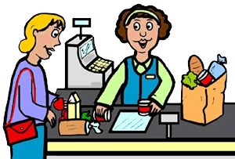
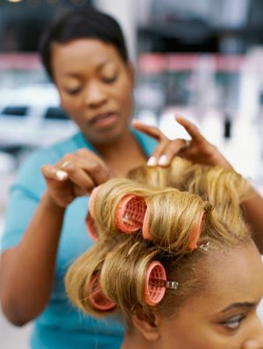
Goods
Items that can be bought and sold.
Services
Work done for others, like haircuts or car repairs.

Slide 5
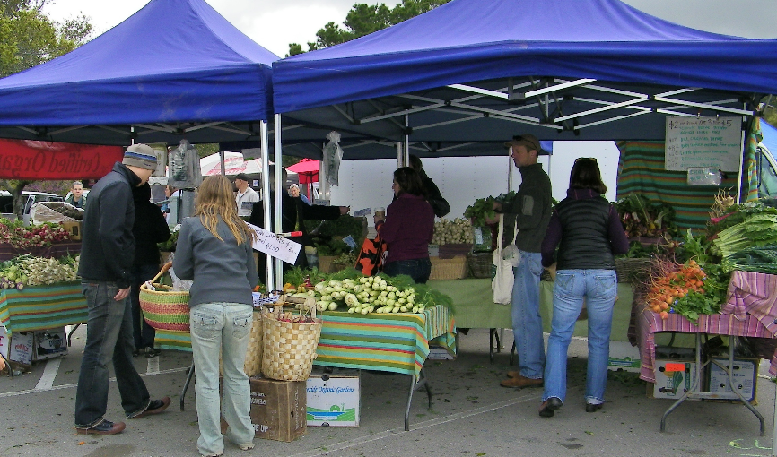
Consumer
Producer
A person who buys goods or services.
A person or business that makes goods or provides services.

Slide 6

Free market economy
A system in which goods and services are bought and sold freely with little government interference.
Profit
The amount of money left after all business expenses have been paid.

Slide 7
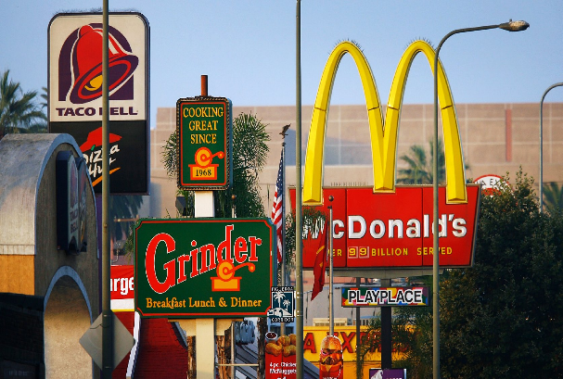
Competition
Rivalry between two or more businesses striving for the same customer.
How does price drive competition?
How does competition drive price?

Slide 8

Review
A free market system generally provides goods and services at an affordable price for consumers, but at a level that lets businesses make a profit and grow.

Slide 9

JA Our Nation
Session Two Objectives:
Innovation Nation
Define entrepreneur and entrepreneurship.
Describe resources and how businesses use them.
Explore STEM skills and the process of innovation.

Slide 10

Entrepreneur
A person who takes a risk to start a business with the intent of earning a profit.
Entrepreneurship
The innovative thinking needed to start and operate a business.

Slide 11
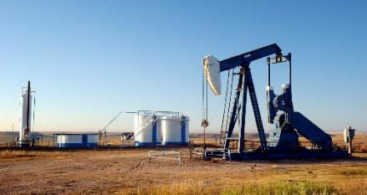
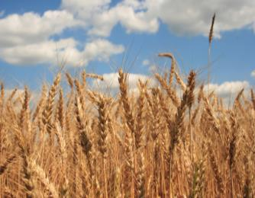

Resources
Things businesses use to produce goods and services.

Slide 12
Types of Resources
Capital resources:
Human resources:
Natural resources:
Buildings, tools, machines, and money that businesses use to make products.
People who do the work that a business needs.
Things that a business needs that occur naturally, such as air, water, minerals, and trees.

Slide 13
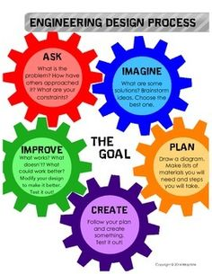

Slide 14


Innovation
An improvement of an existing product or method.
Skill
The ability to do something well.

Slide 15
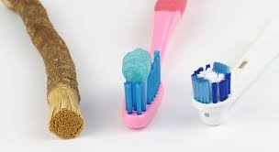
Wouldn’t it be great if…?
Define the problem
Brainstorm a solution
Formulate an idea to develope
Sketch a design
Present your innovation

Slide 16
Review
How do entrepreneurs help consumers?
What is the reward for many entrepreneurs?
What types of resources do businesses need?

Slide 17

JA Our Nation
Session Three Objectives:
Career Quest
Examine career groupings and the skills necessary for different occupations.

Slide 18


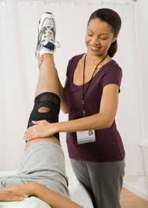
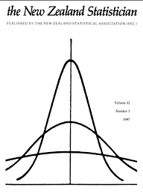


High-growth, high demand jobs
Jobs projected to add large numbers of employees to the workforce.

Slide 19
Advances in Technology
What negative effect can rapid advances
in technology have on the work force?
Can you think of any jobs that exist now, but may not exist in 10 years?

Slide 20

STEM Skills
What skills might a video game engineer need?

Slide 21

Interests
The things you like and enjoy.
Interview your neighbor to find out their interests.

Slide 22



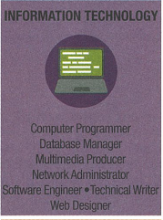
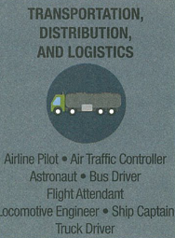
Career cluster
A grouping of jobs and industries related by skills or products.
Career Quest

Slide 23
Review
What are you learning in school today that will help you prepare for a job in the future?
I would really like to learn more about work by spending time with someone who works as a ______?

Slide 24

JA Our Nation
Session Four Objectives:
Get and Keep the Job!
Identify the soft skills wanted by today’s employers.

Slide 25

Employees
People who work for businesses.
Employers
Businesses that hire workers.

Slide 26
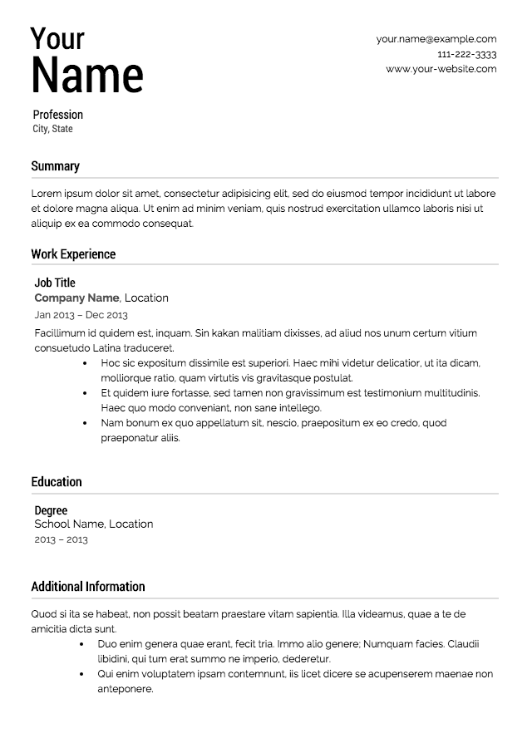
Resume
A written summary of a person’s education, work experience, and skills.

Slide 27


Soft Skills
Personal attributes and abilities that are needed in most jobs.
Communication
Written or spoken exchanges between people to share information.

Slide 28

Job Interview
The discussion between a potential employee and employer to help decide if a job is a good match.
It’s important to practice your interview skills before you have a real interview.

Slide 29

Get and Keep the Job!
Collect as many work-readiness skill points as possible.

Slide 30
Review
For a business to be profitable it must hire the best employees.
The things you learn now can lead to skills you will need in the workplace.

Slide 31

JA Our Nation
Session Five Objectives:
Global Connections
Explain why businesses specialize and trade their products.
Define opportunity cost.

Slide 32

Global Marketplace
The buying and selling of goods and services between businesses and consumers in just about every country around the world.
95% of the world’s customers live outside the United States
What are the advantages of a global marketplace
What are the advantages for U.S. businesses?

Slide 33
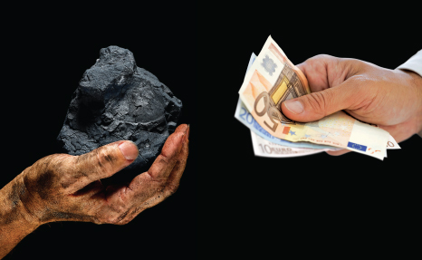
Trade
The process of buying and selling.

Slide 34
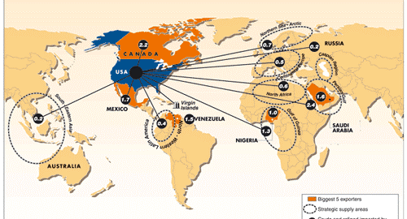
Global Connections
  If you could visit anywhere in the world, where would it be?
  The global market is experienced by just about everyone in our nation.

Slide 35



Specialization
Choosing to focus production on one or a few products.

Slide 36
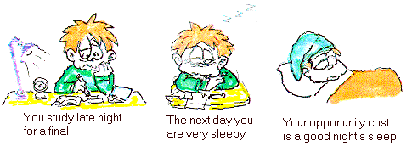
Opportunity cost
The next best alternative given up when making a choice.

Slide 37

Mystery Puzzle Cards
  Locate the other resources needed to produce your product.
  What other resources might be needed for your product?
  What are some of the challenges of having to get resources from a global market?

Slide 38
Review
In this program you learned about:
Free market system
How entrepreneurs innovate
Job skills in demand for today’s businesses
How businesses connect in a global market

Slide 39
JA Our Nation
Graduation
  Thank you for participating in Junior Achievement!

