Slide 1
JA Economics for Success
Name
Title
Company

Slide 2

JA Economics for Success
Session One Objectives:
Mirror, Mirror
Use personal reflection to explain self-knowledge.
Apply your skills, interests, and values to help determine a potential career path.

Slide 3
Tell me about yourself…
What do you do well?
What are you most proud of?
What three qualities describe you best?

Slide 4



Self-knowledge
A person’s awareness of the special qualities he or she has, including skills, interests, and values.
Decision making
The process of choosing among alternative courses of action.

Slide 5
Values
A person’s beliefs and ideals.
Skills
Interests
A person’s talents or abilities.
A person’s preferred activities or hobbies.

Slide 6
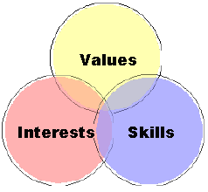
Self-Knowledge Treasure Hunt
Decide on the skills you want to develop, interests you have, and values that are important to you.

Slide 7

Career Clusters
Groupings of jobs and industries that are related by knowledge and skills.

Slide 8

Review
There is a strong relationship between self-knowledge and the working world.
Page 4 of your newsletter has instructions on accessing the JA Online Career Assessment.
Use this assessment to measure your skills, interests, and values.

Slide 9

JA Economics for Success
Session Two Objectives:
Be a Success
Identify the connection between goal-setting, personal finance, education, and career choices.
Apply decision making to education and career choices.

Slide 10

Setting Your Career Goals
Where do you see yourself after high school?
Do you plan to go to college or trade school?
What skills would you like to
acquire?
What about having a career
excites you?

Slide 11
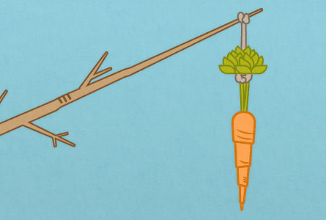
Motivation
A driving force that directs a
person’s behavior.
Monetary Incentive
The financial reward that motivates a person to take an action.
Non-monetary Incentives
A reward other than money that motivates a person to take an action.

Slide 12

Goal
Something that a person wants or works for.

Slide 13
Marine Biologists study salt water organisms.
Skills | Education | Career | Possible Road Blocks
Marine biology centers on molecular biology, the study of the biochemical processes that take place inside living cells. Marine biologists are sometimes called oceanographers.* | Most biological scientists need a doctorate degree in biology or a subfield to work in independent research.* | Biologists work 40-hour weeks, working in laboratories or offices. The median annual pay in 2013 was $57,429 or $27.61 an hour.* | Tuition assistance is available in the form of academic and athletic scholarships, grants, work-study programs, college savings plans, and federal student loans.
*Source: www.bls.gov

Slide 14
My Career Goal
Pocket Guide
Step 1
What is my career goal? In one or two sentences describe what you want to accomplish.
Step 2
Step 3
Will I need a two-year or four-year degree or special training?
Step 4
On a scale of 1-10, how motivated am I to achieve my career goal?
Step 5
What are possible road blocks?
Step 6
What resources are available to me?
What do I want/need to know about my career choice?

Slide 15
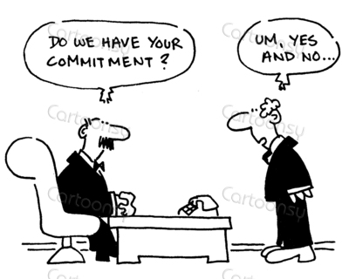
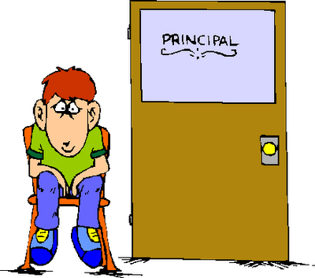
Commitment
The act of pledging yourself to a course of action.
Consequence
The result of a decision or action.

Slide 16

Be a Success Game
Education and work
choices intersect
throughout a lifetime.
Success is a combination
of motivation, planning
and learning to negotiate unexpected events.

Slide 17
Review
How would you handle setbacks to your career goals?
You can play a virtual game that explores education and work choices at the URL on your wristband or at ja.org/jaeconomicsforsuccess.

Slide 18
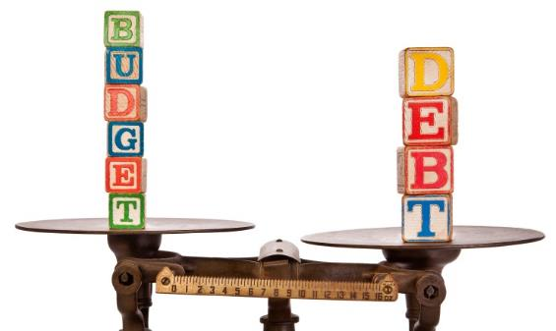
JA Economics for Success
Session Three Objectives:
Keeping Your Balance
Recognize that a balanced budget is important for all workers.
Define the term income and differentiate between gross and net income.
Name ways to balance a budget.

Slide 19



Self Portrait
Budget
A careful plan for spending or saving within a certain period of time.
Dream Vacation
How much will it cost?

Slide 20
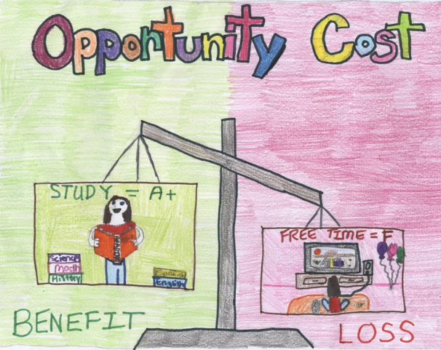
Expenses
Income
The amount earned from wages or other sources.
The amount spent to make purchases and pay bills.
Opportunity Cost
The next best alternative that is given up when a choice is made.

Slide 21
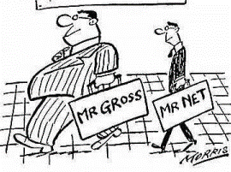
Gross Income
Net Income
Income before all taxes have been deducted.
Income after all taxes have been deducted.

Slide 22
Keeping Your Balance
Create a budget based on your occupation and salary.
“Pay yourself first” by adding to savings, big purchases or emergencies funds.
Make your budget choices.
The goal is to spend less than you earn.

Slide 23
Review
What can you conclude about the relationship between education and income?
You can read A Short, Short History of Social Security and Medicare in your Keeping Your Balance Fliers at home.

Slide 24

JA Economics for Success
Session Four Objectives:
Savvy Shopper
Identify the differences between debit and credit cards.
Explain the advantages and disadvantages of both cards.
Recognize the importance of taking personal responsibility for financial decisions.

Slide 25
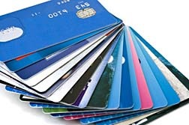
Credit vs Debit
How do your parents pay for everyday goods and services?
What is the difference between a credit and debit card?
How do you decide when
to use a debit or
credit card?

Slide 26
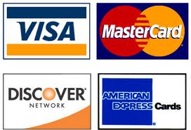
Debit Card
A card that pays for a purchase directly from a checking account.
Credit
The ability of a consumer to buy goods or services before paying for them, based on an agreement to pay later.

Slide 27
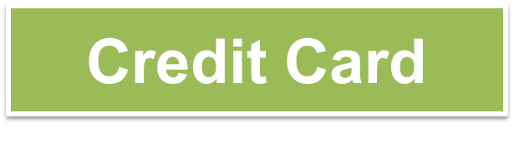
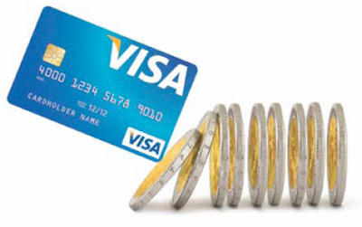
Interest
A card that allows users to make purchases through a limited personal loan, with the expectation that the money will be repaid at a later date, often with interest.
A charge for a loan, usually expressed as a percentage.

Slide 28
Savvy Shopper Challenge
Test your knowledge of credit and debit cards.
Scoring
3 points for each correct answer
5 points for the yellow highlighted questions
Bonus points: share your answers for the highlighted questions for 15 extra points.

Slide 29
Review
Tell me “Two Truths and One Untruth” about credit or debit cards.

Slide 30
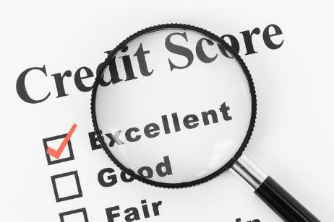
JA Economics for Success
Session Five Objectives:
Keeping Score
Students examine how a credit score is determined and learn about the consequences of a positive and negative credit report.

Slide 31
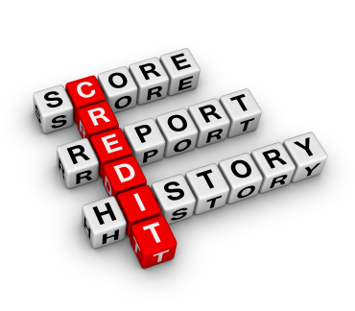
Credit Score
A standardized measurement of
the potential for a borrower to
repay debt.
Credit is based on the trust that a
loan will be repaid in the future.
A credit score is a reflection of the how much trust is established by a borrowers financial history.

Slide 32

Credit Scores Limit your Choices
Credit scores may be looked at by:
              Lenders
              Property owners
              Insurance companies
              Telephone and utility companies

Slide 33
Credit score is based on 5 factors
Payment history; paying bills on time
How much credit you have compared to what you use
Account age and activity
Credit inquiries
Types of credit
= 33%
= 30%
= 15%
= 10%
= 10%

Slide 34

Keeping Score Card Game
This game demonstrates what specific actions can raise or lower a credit score.

Slide 35
Review
Personal and financial choices affect your credit scores.
Credit scores can affect many other aspects of your lives.

Slide 36

JA Economics for Success
Session Six Objectives:
What’s the Risk?
Explore the cost and consequences of risk.
Explain how insurance provides a method to minimize financial risk.
Identify the opportunity cost of having insurance.
Assess how personal responsibility plays a part in minimizing risk.

Slide 37


Risk
The possibility of financial loss or physical harm.
Insurance
A contract that protects a person against financial loss or damage.

Slide 38

Preparing for Unexpected Events
Insurance is…
  about protecting yourself from the “what ifs”;
  a safety net;
  necessary if you choose to participate in riskier activities.

Slide 39

Premium
Policy
The amount paid for an insurance policy.
A written contract for insurance.
Deductible
Co-pay
Money paid out-of-pocket before insurance covers remaining costs.
A fixed fee an insured person must pay for a service.

Slide 40


Risk Categories:
Home
Health
Car
Dental
Phone
Notes:
Consider editing the Personal Profiles using your own life as a model.

Slide 41
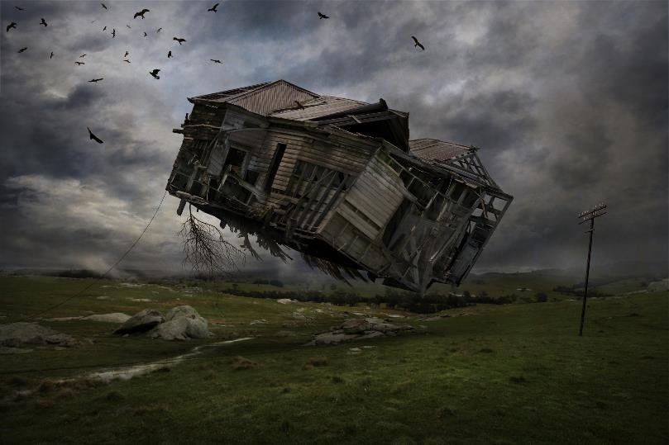
Total Loss
When the cost of repair is greater than the property’s value.

Slide 42
Review
Things outside of your control can affect your budgets and financial well-being.
One way to minimize the cost of such risks is to have insurance.

Slide 43
Certificates of Achievement
  Thank you for participating in Junior Achievement!

