Slide 1
JA It’s My Business
Name
Title
Company

Slide 2

JA It’s My Business
Session One Objectives:
I am an Entrepreneur
Define entrepreneurship.
Identify four key entrepreneurial characteristics.
Recognize personal entrepreneurial characteristics.

Slide 3


Entrepreneur
A person who starts his or her own business with the intent of earning a profit.
Business
A company or organization that sells products or provides services.
Profit
Income earned after all expenses are paid.

Slide 4
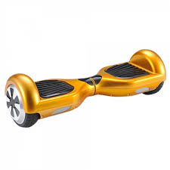
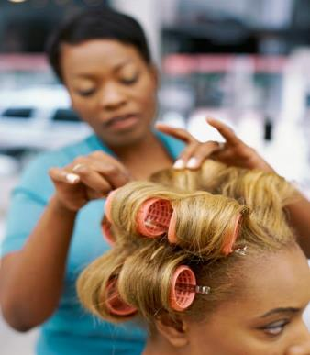
Product
An item created for use or sale like a car or CD.
Services
Providing something useful, like haircuts or car repairs.

Slide 5
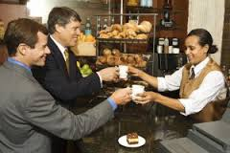

Customer
A person who purchases a product or service.
Innovative
To create something new, original, or groundbreaking.

Slide 6
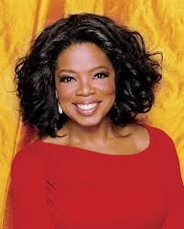
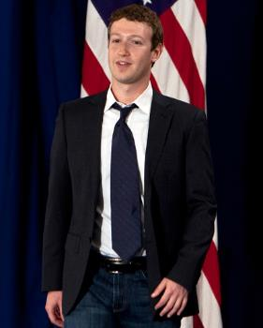
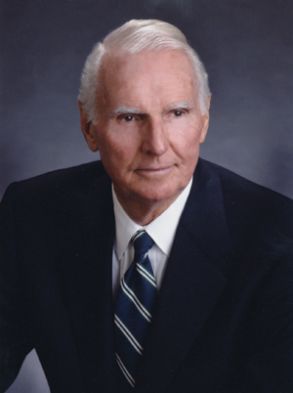
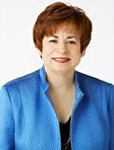
What companies did these entrepreneurs found?
Notes:
Oprah Winfrey – OWN Network
Mark Zuckerberg – Facebook
Jack C Taylor – Enterprise Rent a Car (St. Louis)
Maxine Clark – Build-a-Bear Workshop (St. Louis)

Slide 7
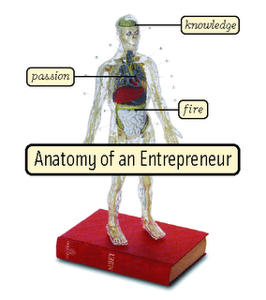
As an entrepreneur you must:
Fill a Need
Know your Customer and Product
Be Creative and Innovative
Believe in Yourself

Slide 8
E-Quiz Game Show
1. Mystery Guest
2. Show Business
3. Revenge of the Nerds
4. Food for Thought

Slide 9

Review
Entrepreneurs share similar characteristics.
How are you like the entrepreneurs we discussed today?
What will you have to learn or do to be like them?

Slide 10

JA It’s My Business
Session Two Objectives:
I Can Change the World
Describe how entrepreneurs fill a market need.
Discuss the role of market research in determining market need and competitive advantage.

Slide 11

Design a Teen Club using Entrepreneurial Skills
Fill a Need
Know your Customer and Product
Be Creative and Innovative
Believe in Yourself

Slide 12

Creative
To think imaginatively and resourcefully.
Apprentice
A person who studies with experts in their chosen field.
Self-taught
A person who learns on their own as much as possible about a product, service or business.

Slide 13


Fill a need
To create a product or service people want to buy or use.
Market
A collection of current and/or prospective customers.
Market Research
Gathering and evaluating data regarding customers’ preferences for products and services.

Slide 14

Brainstorming
A method used to generate ideas.
Think creatively and innovatively as you brainstorm ideas for your Teen Club Blueprint.

Slide 15
Entrepreneur’s Checklist
  Fill a Need
    What customer needs does your Teen Club meet?
    Where should the club be located?
  Know Your Customer and Product
    Who are your customers?
    What products could you sell?
  Be Creative and Innovative
    What is special, new, or different about your Teen Club?
    What appealing, cutting-edge element could your club offer?
  Believe in Yourself
    What skills and knowledge do you need to have?
    Is this a Teen Club you could be passionate about creating and promoting?

Slide 16
Review
Entrepreneurs need to ask themselves a lot of questions when they think about starting a business, product or service.
They must think about the market, its needs and how they can be successful.

Slide 17
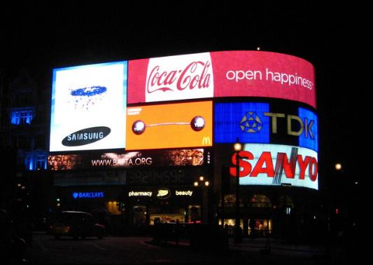
JA It’s My Business
Session Three Objectives:
I Know My Customer
Create effective advertisements for a variety of businesses.

Slide 18
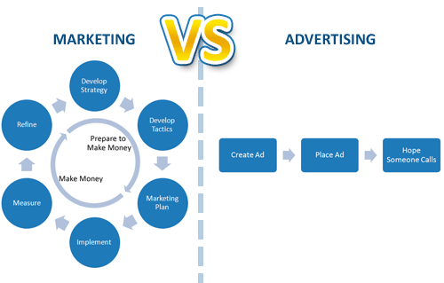
Advertising
Marketing
The means by which a product or service is made known and sold to customers.
The promotion of a product or service.

Slide 19

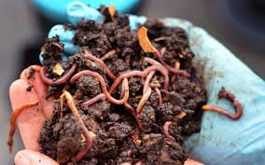
Worm Waste
Buy Worm Waste and watch your garden grow!
I studied worms and plants and created this natural fertilizer that will help your garden grow healthy plants.

Slide 20
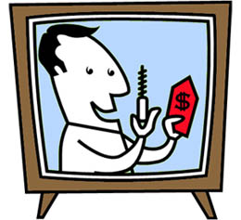
That Can’t Be Real!
Create a commercial for one of the products.
Use a song, rap, skit, monologue or other form of communication.
Include key information about the product and why someone should buy it.
Create a slogan, logo,
or print advertisement.

Slide 21
Review
Advertising is just one tool entrepreneurs use to market their product or service.
You must be an expert on your product or service to create effective advertisements.

Slide 22

JA It’s My Business
Session Four Objectives:
I Have an Idea
Recognize how being creative and innovative are necessary entrepreneurial skills for starting a business.
Verbally defend your decisions.

Slide 23

Auction
Bid
A way to buy a business for which the price has not been set.
Offering an amount as the price for something.

Slide 24

Auction!
Bid on creative and innovative businesses.
Begin bidding after all three clues are read.
Raise your hand to bid.
Once you spend your $10,000
you may no longer bid on any more
businesses.

Slide 25
Review
Successful entrepreneurs are creative and innovative.
They have great ideas, and they act on those ideas – quickly.

Slide 26

JA It’s My Business
Session Five Objectives:
I See a Need
Analyze how entrepreneurs use their knowledge and abilities to create businesses.
Develop business plans based on set criteria.

Slide 27

Social Entrepreneur
A person who sees a need in a society or a community and pursues a solution using his or her entrepreneurial skills and sound business practices.
Society
A community or people sharing customs, laws and organizations.

Slide 28
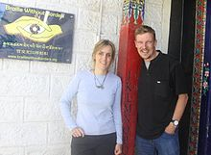
Sabriye Berkin
Social Entrepreneur
Lost her eyesight at age 13.
Established the first school for the blind in Lhasa, Nepal
Started Braille Without Borders – an international organization for the blind in developing countries.

Slide 29
As an entrepreneur you must:
Fill a Need
Know your Customer and Product
Be Creative and Innovative
Believe in Yourself

Slide 30
Be a Social Entrepreneur
  Develop a business plan that describes what the business is about, what is important to it, and how it will operate.
Project Manager: responsible for keeping the team on task
Team Designer: responsible for visualizing the business plan
  Team Spokesperson: responsible for presenting the plan
  Quality Lead: responsible for ensuring that the plan clearly addresses the need

Slide 31




Business Plan Presentations

Slide 32
Review
Most entrepreneurs choose their business based on:
their enthusiasm for it
the need it fills
and the ability to make a difference in the lives of their customers.

Slide 33

JA It’s My Business
Session Six Objectives:
Celebrate Entrepreneurs!
Identify characteristics you share with entrepreneurs.
Create a Personal Entrepreneur Profile.

Slide 34
Entrepreneur Profile Cards
Review your entrepreneur profile.
You may trade with a classmate during the trading period.
Describe how the entrepreneur demonstrated one of the four entrepreneurial characteristics.
Describe how you are like the entrepreneur you selected.

Slide 35
As an entrepreneur you must:
Fill a Need
Know your Customer and Product
Be Creative and Innovative
Believe in Yourself

Slide 36
Personal Entrepreneur Profile
My Life Now
Home: St Louis, MO
Education: Student
Profile: Like science, collecting bugs, and gardening.
Power: Work hard for long hours without complaint. Love for bugs, desire to help people, dream to travel.
Vision: Study bugs and gardening. Volunteer at a science or horticultural center. Need a passport to travel.
Success: Fastest eater in the seventh grade.
Notes:
Consider editing the Personal Profiles using your own life as a model.

Slide 37
Personal Entrepreneur Profile
My Future Life
Home: Monte Verde, Costa Rica
Education: Ph.D. in Entomology
Profile: Own a bug farm and sell bugs that help farmers with their crops.
Power: Discovered a bug that eats other bugs and disease spots that harm crops. Found out about them first.
Vision: Beat out all competitors by being the first to find and sell the good bugs. This business makes a difference in people’s lives.
Success: More than 20 billion bugs sold. Crop yield for farmers has increased by 50 percent.

Slide 38
Review
This session you identified the fourth entrepreneurial characteristic – Believe in Yourself.
Use entrepreneurial thinking as you map out the dream for your future.

Slide 39
Certificates of Achievement
  Thank you for participating in Junior Achievement!

