Slide 1
JA It’s My Future
Name
Title
Company

Slide 2
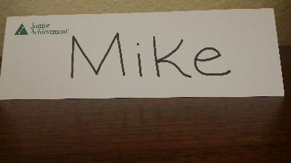
JA It’s My Future
Session One Objectives:
My Brand
Recognize the choices we make now can have a direct impact on our future
Identify corporate and personal brands that represent positive reputations.
Design a logo as part of expressing a personal brand.

Slide 3
Think of a trip you have taken…
Once a journey begins, any wrong turn, change of plans, or delay affects the rest of the journey.
Your choices now will expand or limit your opportunities in the future!

Slide 4




Brand
A company’s brand is its promise to it’s customers. It’s the communications strategy that helps you communicate your passion and expertise.

Slide 5



Logo
A recognizable graphic design element that represents a business, a product, or a person.

Slide 6
Tagline
A brief slogan used in marketing to define a business, a product, or a person.
  Finger lickin’ good
  Have it your way
  Melts in your mouth, not in your hands
  They’re….Gr-r-reat!

Slide 7
Personal Brand
Personal branding highlights what you are known for, what people seek you out for and what you want to be known for.
Are you great at…
Math
Lacrosse
Being a supportive friend

Slide 8


Slide 9


Slide 10


Slide 11
What does branding have to do with getting ready for the working world?
What would happen if a company had a bad image or poor reputation?
Would you trust the company again?

Slide 12

Brand Interview
Activity
(7 Minutes)

Slide 13

Your Personal Brand
What impression will future employers have of you based on your social media presence?

Slide 14





Activity
(7 minutes)
Design Your Personal Brand Logo

Slide 15

Review
People, like companies, express themselves through their actions, appearance, and choices—all of which build a reputation.
Students: Future employers will look at what brand you have built for yourselves when deciding whom to employ.

Slide 16

JA It’s My Future
Session Two Objectives:
Career Clusters
Examine career clusters and the jobs in each cluster that you would like to further explore.
Understand the interconnectivity and value of all types of jobs.

Slide 17

Close your eyes and imagine your future.

Slide 18

Your future
How do you achieve that goal?
What education do you need?
Do you need specialized training?
Does it pay well?
Are you the boss or do you work for your dream company?

Slide 19

Career Cluster
Groups of jobs and industries that are related by skills and products.
16 categories created by the US Department of Education

Slide 20
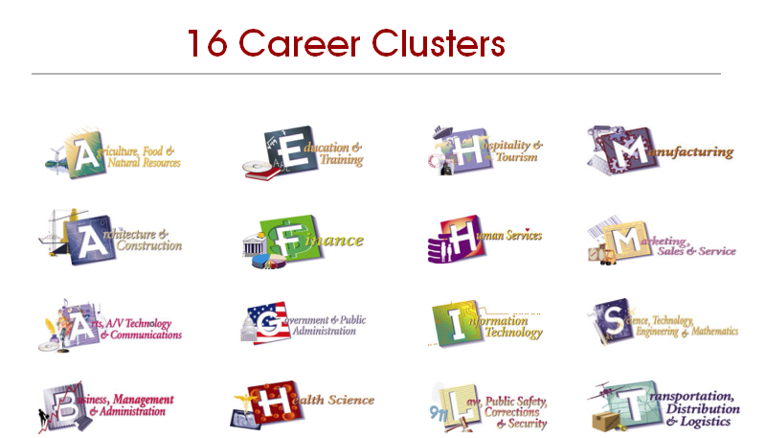

Slide 21
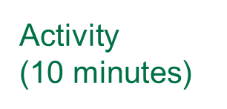

Examine the Career Clusters
What is the favorite job you found?
Did you learn any new jobs?
What if no one chose to do certain jobs?

Slide 22
These are just a FRACTION of what is actually available!
Go to the JA Student Center at studentcenter.ja.org
to learn more.

Slide 23
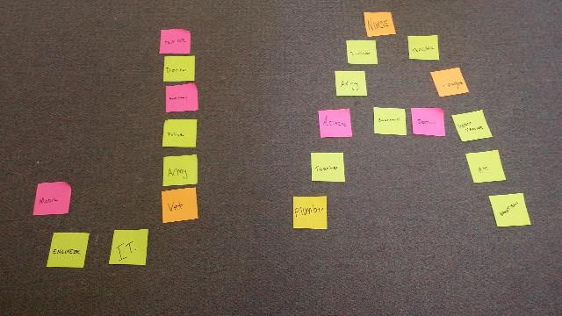
Activity
(10 minutes)
Create a Job Mural

Slide 24
Review
You have identified possible jobs from the career clusters now, to help you make good decisions in the future.
Few people stumble into interesting jobs. Those come with planning, training, and education.
The first step in planning the future is knowing what skills and interests you have and will need.

Slide 25

JA It’s My Future
Session Three Objectives:
High Growth Careers
Recognize the four factors to consider in choosing a job.
Examine industries that are forecasted to have high growth.

Slide 26
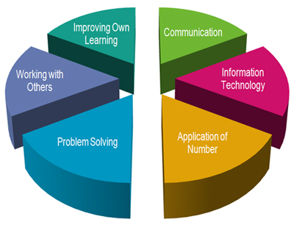
Skills
A person's talents
or abilities.

Slide 27

Interests
A person's preferred activities or hobbies.

Slide 28

Work environment
The quality of life related to a job position, including physical conditions and personal factors.

Slide 29
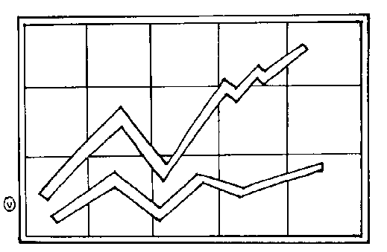
Job outlook
A prediction of the future number of certain jobs, based on changes in society and the economy.

Slide 30


High-growth jobs
Occupations predicted to have more positions available than qualified applicants over the next 10 years.

Slide 31
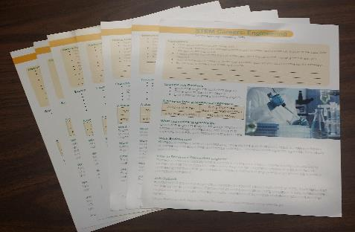

Activity
(15 minutes)
Career Fair Recruiting

Slide 32
Review
Want to know more about these fields?
Find detailed information at the JA Student Center’s Career Exploration page at
studentcenter.ja.org
Activation Code: N3235773GYT

Slide 33
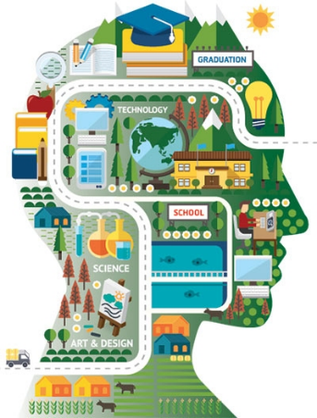
JA It’s My Future
Session Four Objectives:
Career Mapping
Identify work skills already developed from experiences and activities.
Plan significant markers you need to reach to earn a particular job.

Slide 34

Would you like to be a veterinarian?

Slide 35
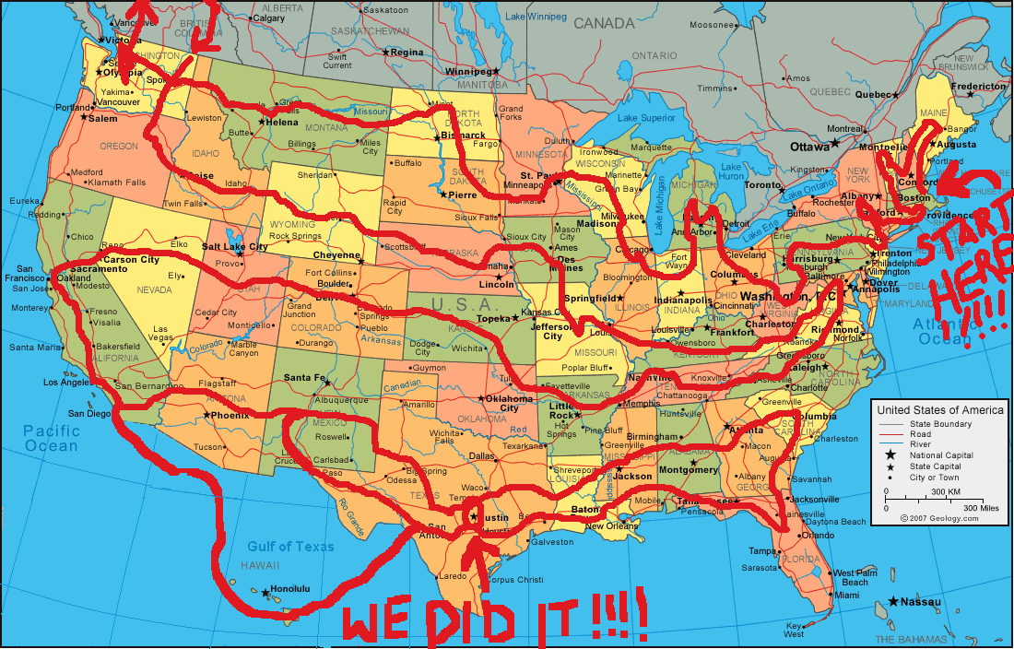
If you had to drive across country how would you know where to go?

Slide 36
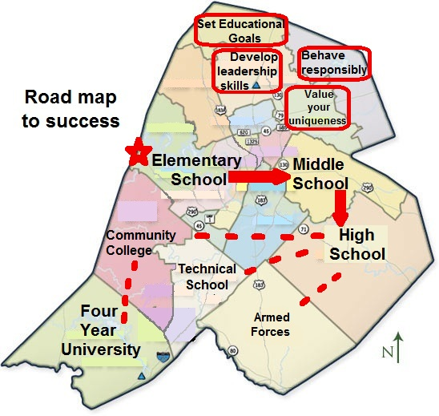
Activity
(15 minutes)
Create Your Career Map

Slide 37
Fill In Your Personal Map
Reminders:
Elementary: find examples of milestones, events, clubs, or other activities that helped you form positive work habits.
Middle-school: brainstorm milestones you have accomplished or could accomplish to help you become a successful employer in the future.
Short-Term goal: list one thing you can do in the next two weeks that could help you prepare for a career or learn more about one that interests you.
High School/Post-High School: add milestones you need to reach to achieve the career you want

Slide 38

Review
What skills or experiences could help you on your career journey?
Join a service organization
Get a part-time job
Participate in a training program
Volunteer

Slide 39
JA It’s My Future
Session Five Objectives:
On the Hunt
Recognize basic job-hunting tools, including applications, resumes, recommendations and interviewing.
Analyze where to look for a job
Understand the importance of keeping a record of vital information.

Slide 40

Activity
(15 minutes)
Scavenger Hunt

Slide 41
How do you…
  ….find an open job position?
  ….fill out a job application and offer a resume?
  ….participate in a job interview?

Slide 42
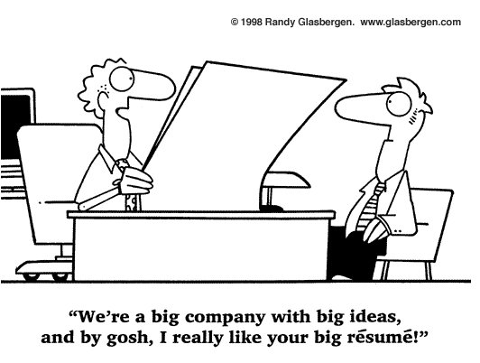
Resume
A written summary of a person's education, skills, and work experience.

Slide 43

Activity
(15 minutes)
Practice Your Job Interview Skills

Slide 44
Review
What tips did you learn today?

Slide 45
JA It’s My Future
Session Six Objectives:
How to Keep (or Lose) a Job
Differentiate between technical skills and soft skills.
Describe specific soft skills they already possess and those they need to practice.

Slide 46
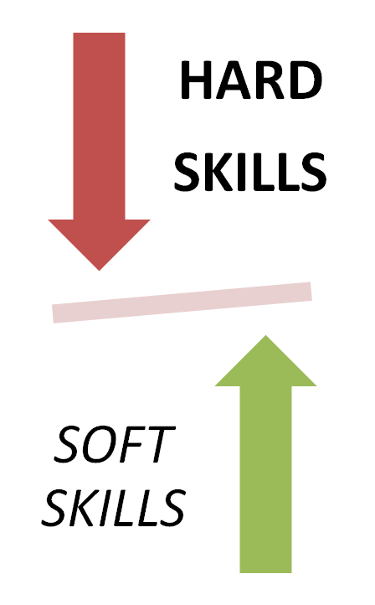
Soft Skills
Personal attributes and abilities not directly tied to a specific job title but which are needed in most jobs.

Slide 47

Technical Skills
The abilities and knowledge used in a specific profession.

Slide 48

How can you keep or lose a job?

Slide 49

Activity
(20 minutes)
Create your career blog

Slide 50
Review
Most jobs are earned through good career planning and strong technical skills. But, often, jobs are lost because of poor soft skills.
Personal behavior matters in the workplace!

Slide 51
Certificates of Achievement
  Thank you for participating in Junior Achievement!

