Slide 1

JA Ourselves
Name
Title
Company

Slide 2
Session 1
Make a Choice

Slide 3

This or That? Make a Choice
Choice
To pick one thing over another.

Slide 4
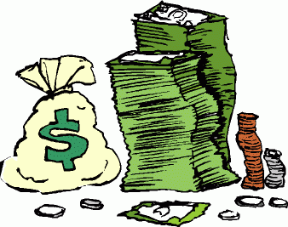
Money
Something used to pay for the things we need and want.

Slide 5



Making choices can be hard so think and choose wisely.

Slide 6
Session 2
Do I Need What I Want?

Slide 7
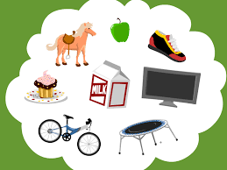
Need
Something people must have to live.
Want
Something people would like to have.

Slide 8

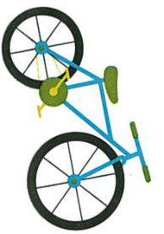









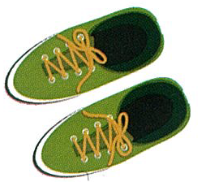
Sort your needs and wants

Slide 9
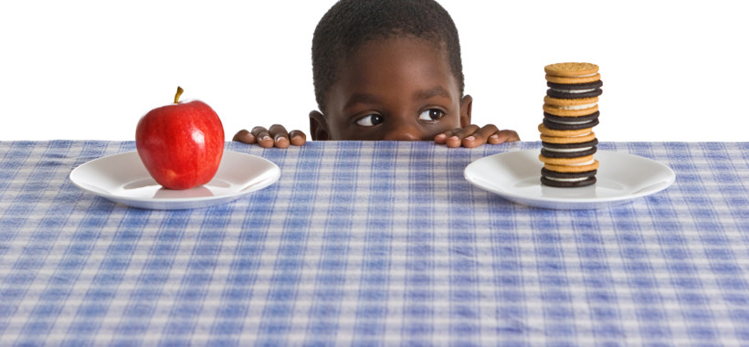
Needs are more important than wants
Review

Slide 10
Session 3
A Penny Earned

Slide 11
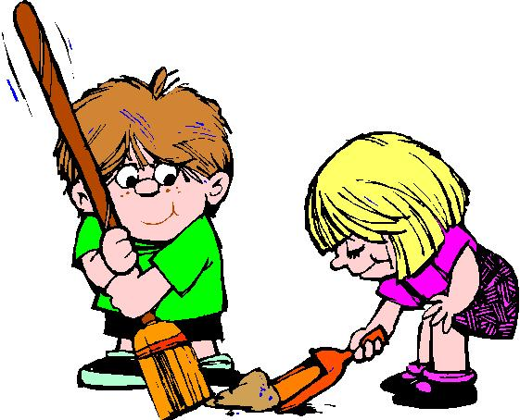
Earn
To get money for a job you did.
Goods
Things that are bought and sold.
Services
Work done for others, such as haircuts or car repairs.

Slide 12
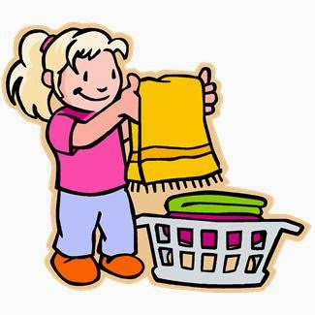
What jobs can you do?
Review

Slide 13
Session 4
A Penny Saved

Slide 14

Save
To put money away to use later.
Bank or Credit Union
A business that keeps money safe.

Slide 15
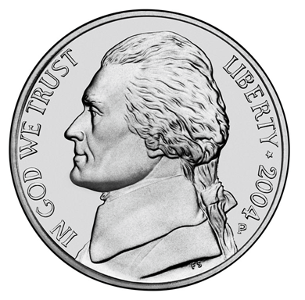
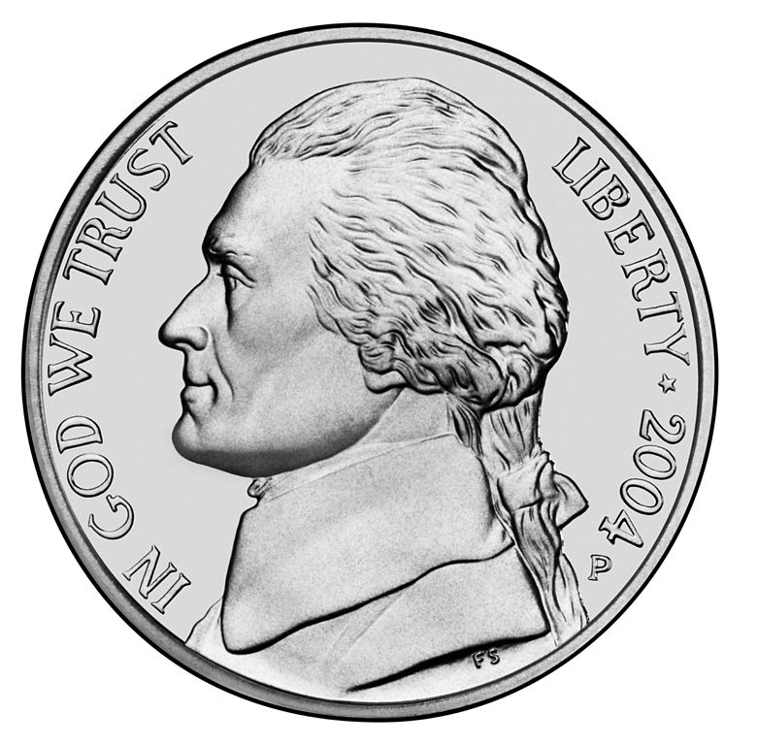
Three Little Nickels

Slide 16
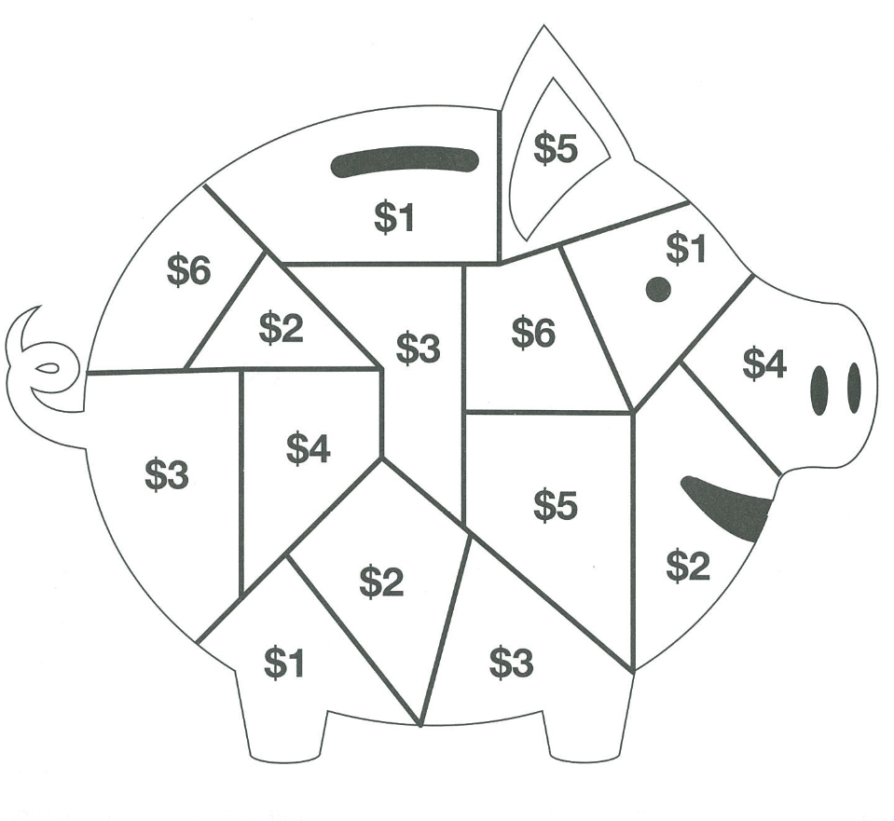

Piggy Bank Game

Slide 17
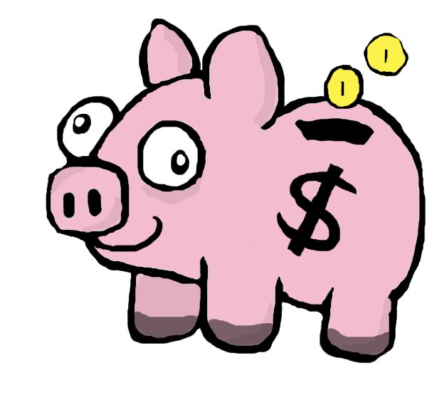
Save your money to reach your goal.
Review

Slide 18
Session 5
A Penny Shared

Slide 19

Give
To make a gift of something.

Slide 20
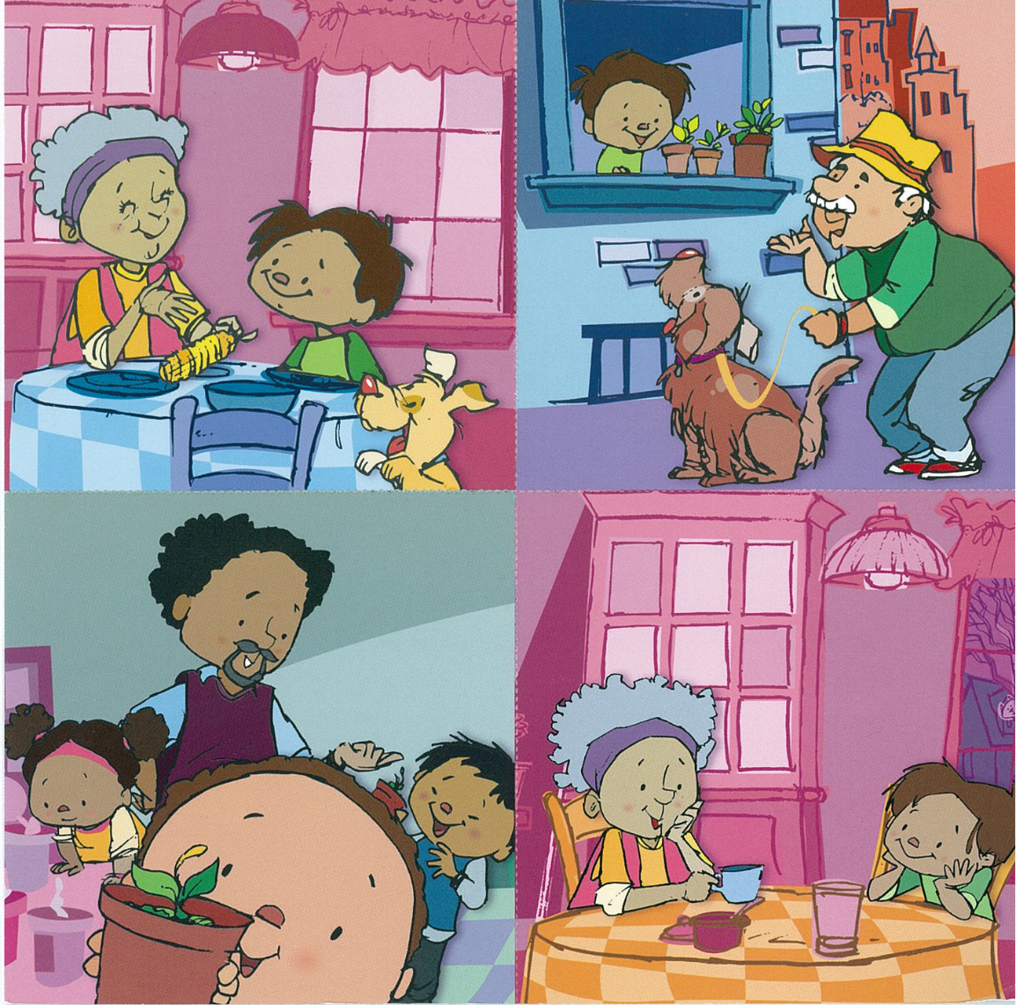
Put the Story in Order

Slide 21
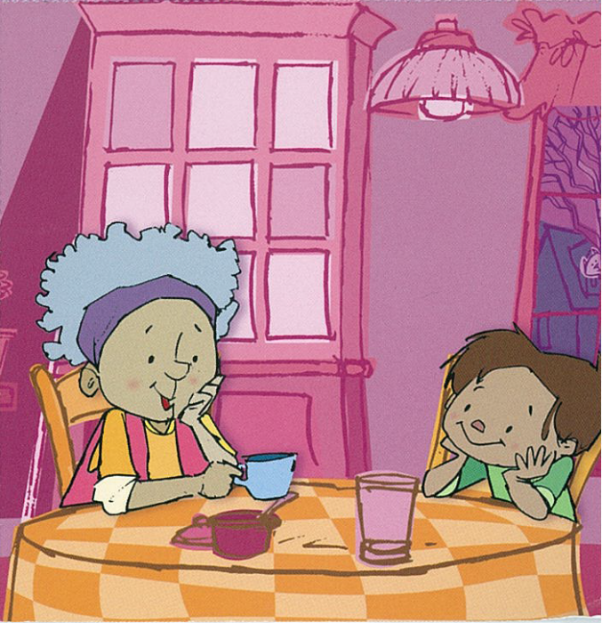
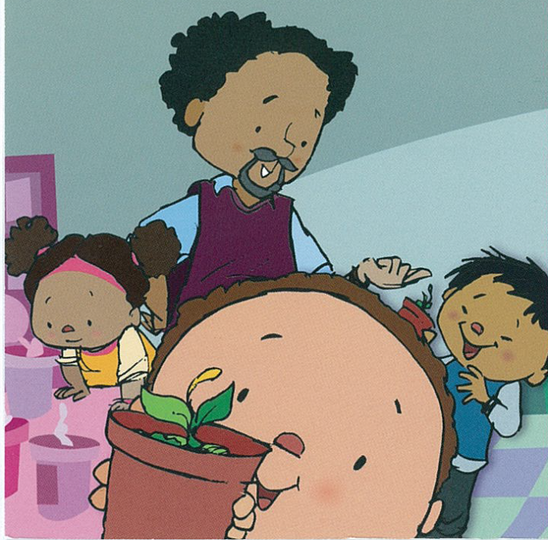
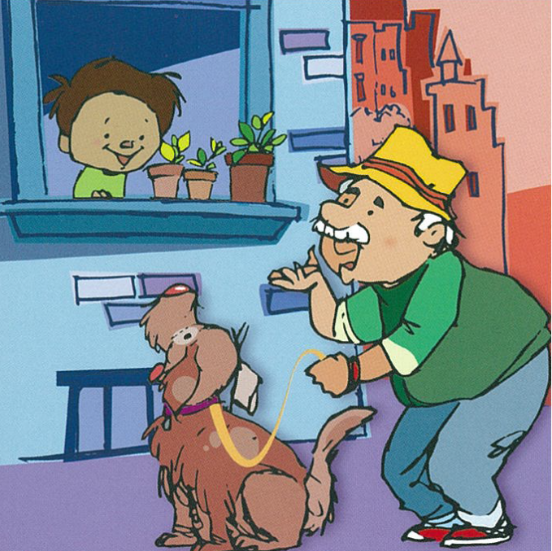
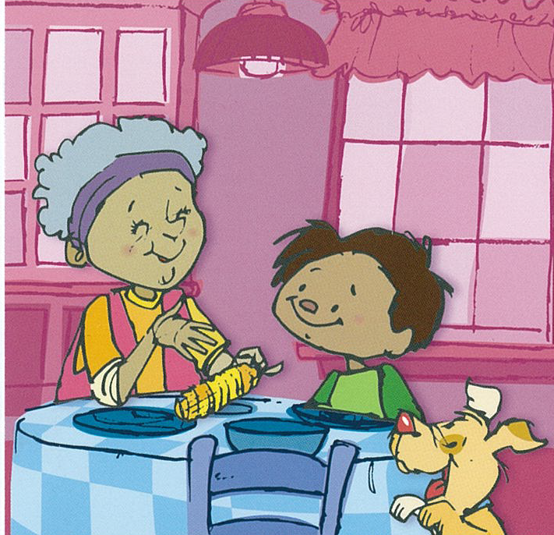
Answers

Slide 22

How can you contribute to your community?
Review

Slide 23
JA – Ourselves
Graduation

