Slide 1
JA Global Marketplace
Name
Title
Company

Slide 2
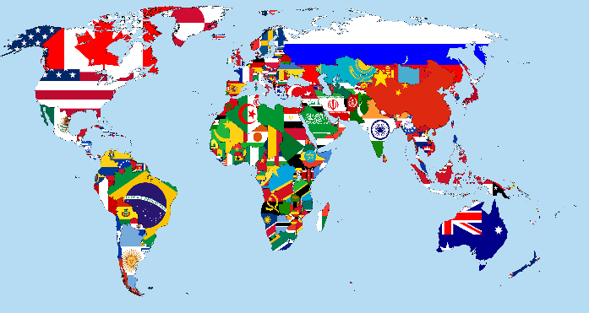
JA Global Marketplace
Session One Objectives:
“X” Marks the Spot
Define trade
Explain why countries trade with one another
List at least five products or items imported from other countries and locate those countries on a world map.

Slide 3

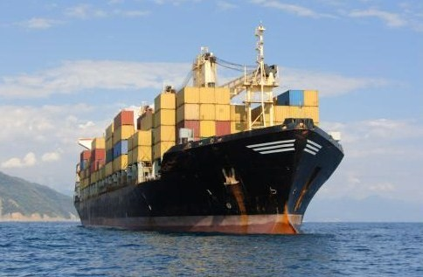
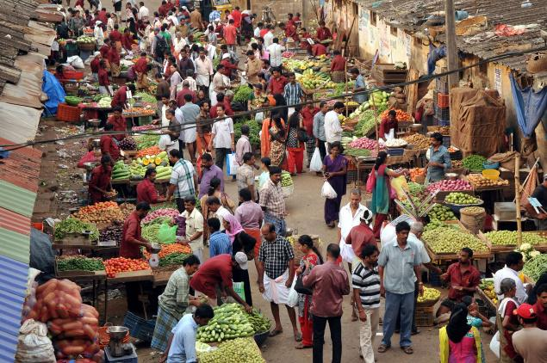
Trade
An exchange of goods or services.
Market
A place where trade occurs.

Slide 4


Domestic Trade
When people and businesses exchange goods or services within their own country.
International Trade
When people exchange goods or services with people in other countries.

Slide 5

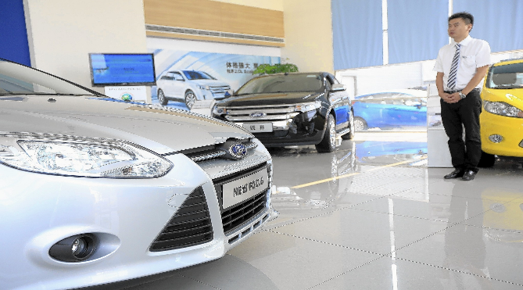
Imports
Goods or services bought from another country.
Exports
Goods or services sold to another country.

Slide 6
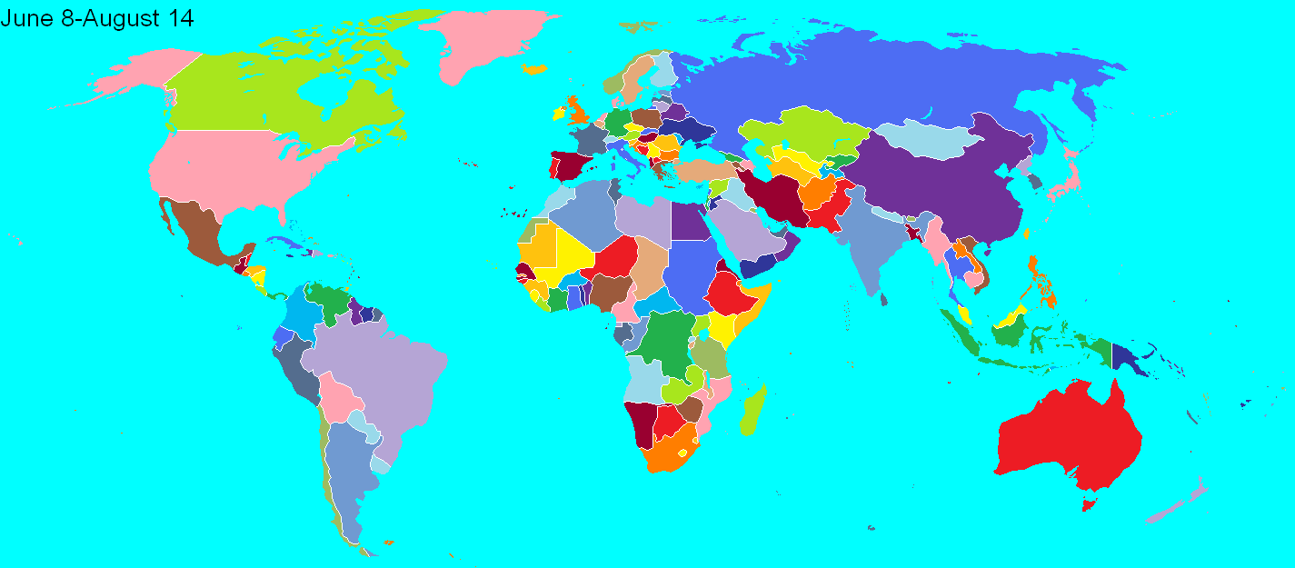
Global Trading Treasures
Identify imports and their country of origin in the classroom.

Slide 7

Review
What makes international trade work?
How has trade affected your life?
Nations trade to acquire goods and services they cannot produce at a reasonable cost.

Slide 8

JA Global Marketplace
Session Two Objectives:
You Be the Judge
Identify trade barriers that governments use to control trade and increase benefits for their countries.
Describe how multi-lateral agreements can facilitate trade.
Describe how the WTO functions as a court to help nations settle trade disagreements.

Slide 9
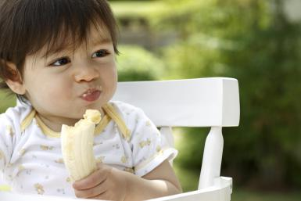

Consumers
People who buy products or services.
Producers
People who make or produce goods or services.

Slide 10
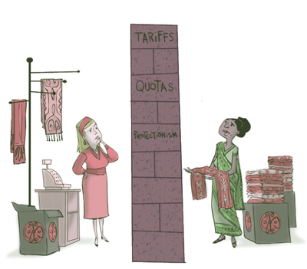
Trade Barriers
A regulation or law that slows or prevents trading with another nation.

Slide 11
Types of Trade Barriers
Quota – a control on the amount of a product that can be imported into a country.
Tariff – a tax on goods imported into a country.
Subsidy – a government action that decreases an industry’s production costs, which also decreases the price of its good(s).
Embargo – a ban on trade with another country for a single good or all goods.
Standard – a requirement that stops or limits the sale of a product not meeting certain specifications.

Slide 12
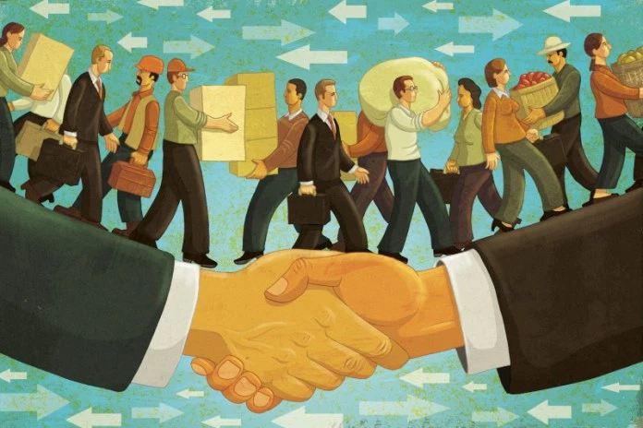
Free Trade
A belief that products should be free to move from country to country without barriers.

Slide 13
North American Free Trade Agreement (NAFTA)
Eliminate trade barriers to help the movement of goods and services between the three countries.
  Promote fair competition in free trade.
  Increase investment opportunities in the three countries.
  Provide protection for and enforcement of each country’s intellectual property rights.
  Create procedures to assist each country in resolving disputes.
  Establish a plan to expand and enhance the benefits of the agreement.

Slide 14

World Trade Organization (WTO)
Functions as a court by hearing and deciding on trade disputes.

Slide 15
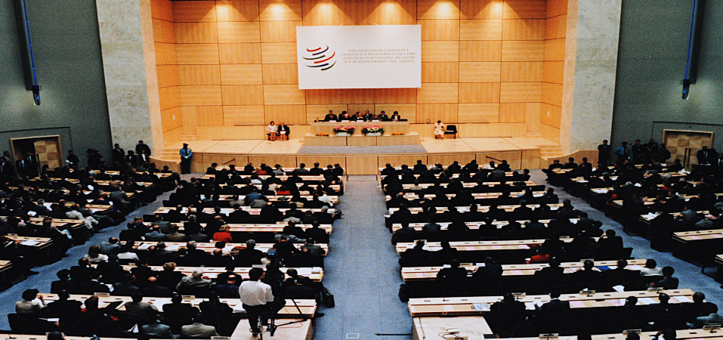
You be the Judge
Read the trade dispute cards and decide which is the ‘right’ or ‘fairer’ resolution.
Summarize your decisions with the class.

Slide 16
Review
Issues with regard to world trade can have compelling arguments for both sides.
Making the “right” decision can be difficult and may not satisfy the needs of everyone involved.

Slide 17

JA Global Marketplace
Session Three Objectives:
Let’s Make a Deal
Explain how cultural aspects of business vary from country to country.
Develop group plans to create a food franchise by learning about the business practices of select countries.

Slide 18
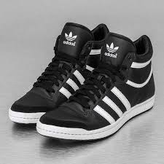
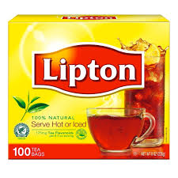

Imports vs Exports
What country do these products originate from?

Slide 19
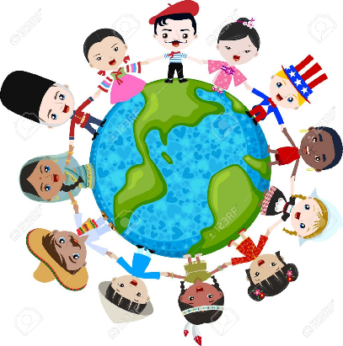
Culture
The way of life of a group of people who share traditions, interests, beliefs and everyday activities.

Slide 20
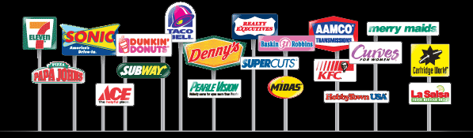
Franchise
A special right given to a business person to sell a company’s products.

Slide 21
Business Practices
Adapt a fast-food restaurant franchise to your assigned country.
Be aware of:
How to do Business
What to Wear
How to Speak
How to Use Professional Titles
Nation Basics
Consumer Basics

Slide 22
Review
Trade generally is improved if we know about one another and can appreciate the differences of our trading partners.

Slide 23

JA Global Marketplace
Session Four Objectives:
People Power
Describe reasons why people move from one country to another, particularly those seeking economic opportunity.
Give examples of contributions immigrants bring to new countries they immigrate to and the hardships newcomers often endure.
Identify global trade and immigration as a means of international exchange of human resources.

Slide 24
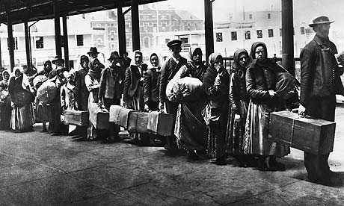
Emigrate
When people permanently leave a country for another.
Immigrate
When people permanently enter a new country from another.

Slide 25
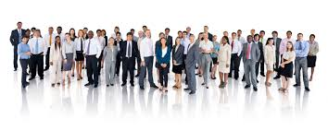
Human Resources
The people who work at a company, business, organization.

Slide 26
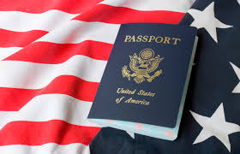
Immigration
How often do you interact with people from other countries?
Consider the hardships and challenges you would endure if you left your home country.

Slide 27
Review
When people move for one reason or another, countries are trading human resources.

Slide 28

JA Global Marketplace
Session Five Objectives:
World of Words
Describe how improvements in technology and transportation, and the sharing of ideas have impacted the flow of information and increased productivity.
Calculate productivity.
List examples of technological developments throughout history.

Slide 29
How many of you have…
Used the internet?
Have a computer and printer at home?
Know what a typewriter it?
Have used a manual typewriter?
Have books at home that were written by hand?

Slide 30
Productivity
The amount of goods produced (output) by a certain number of workers, their resources, and the length of time worked (input).
Productivity =
Output
Worker Hour

Slide 31
Review
Differences in language can slow or prevent communication and trade.
How might companies respond to language issues as they conduct business throughout the world?

Slide 32
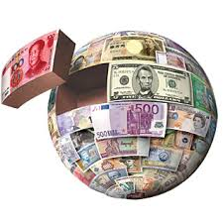
JA Global Marketplace
Session Six Objectives:
World of Money
Explain why international trade requires an exchange of currency.
Convert U.S. dollars into another currency using an exchange rate.
Give possible reasons why countries might support or oppose a common currency.

Slide 33
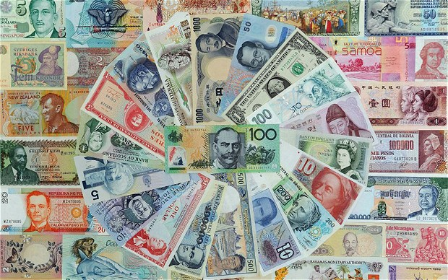
Currency
A nation’s money.

Slide 34
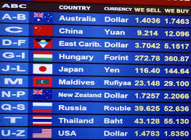
Exchange Rate
The price of one nation’s currency in terms of another nation’s currency.

Slide 35
The Namero
Would it be difficult to give up the cultural and historical identity of your country?
Would the change be good for North American trade?
Would it be good for tourists from around the world?
Would it be expensive and difficult to adapt to?
How might changing the common currency impact the US economy?
Notes:
Consider editing the Personal Profiles using your own life as a model.

Slide 36
Review
During this program we have studied International markets, law, cultural exchange, the flow of human resources, the flow of information and financial capital.
These six key aspects work together to describe the global economy.

Slide 37
Certificates of Achievement
  Thank you for participating in Junior Achievement!

